Slide 1
Attention & Transformers as the Multimodal Backbone
Self-Attention → Cross-Attention → Transformers → Vision • Language • Audio
Dr. Khan Muhammad (칸 무하마드)
Associate Professor
Department of Applied Artificial Intelligence
Sungkyunkwan University

Slide 2
Main contents
From Representations to Attention
Why Do We Need Attention ?
  The importance of the relevant information
  Context and relationships
  Attention as a mechanism for weighting information
  Saliency Detection vs Attention
Self-Attention
  Basic Intuition
  Query, Key & Value
  Attention scores & weights
  How information interacts with the same input
Cross-Attention
  Self vs. Cross-Attention
  How information interacts across different inputs
  Connecting different modalities
From Attention to Transformers
  Positional Encoding
  Why Transformers use attention as a core mechanism
  Multi-Head Attention
  Transformer Architecture
Transformers Across Modalities
  Text → Tokens
  Images → Patches
  Audio → Segments/Representations
  A common attention-based architecture across different inputs
Transformers for Multimodal AI
  Vision + Language
  Audio + Language
  Video + Language
  Cross-modal interaction and understanding
Case study: how a single architecture family underlies vision, text, and audio
Summary & Key Takeaways

Slide 3
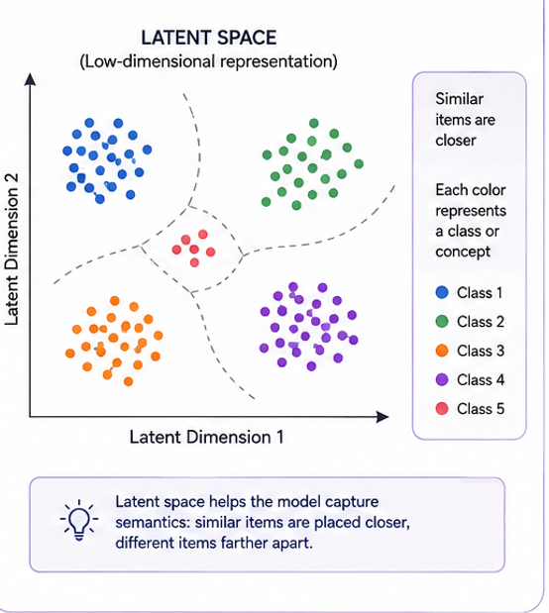

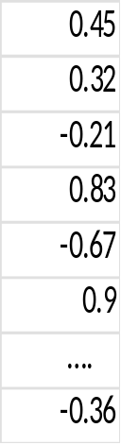




1. What Did We Learn in Previous Lecture (s)?
Deep Learning turns raw data into useful information.
Neural networks, embeddings, and latent spaces convert raw data into meaningful vectors
CNNs and Transformers provide architectural ways to process these representations
Raw Data
Deep Learning Model
Actionable Information
1. Raw Data → Meaningful Representation
2. Latent Space
Raw Data
Processing
Meaningful
Representation
Useful
Information
Images
Prediction
Classification
Search
Insights
Text
Deep Learning is powerful
Audio
Tabular Data
Notes:
Note: Latent dimensions are numerical features learned by the model to represent the input. A latent representation may contain hundreds of dimensions, but we often visualize it using only two dimensions (x-axis and y-axis). For example, the actual latent vector might have 128, 512, or 768 dimensions, but we cannot draw 512 dimensions on a normal graph. A dimensionality-reduction method such as Principal Component Analysis (PCA) or Uniform Manifold Approximation and Projection (UMAP) can map those representations into 2 dimensions for visualization.

Slide 4
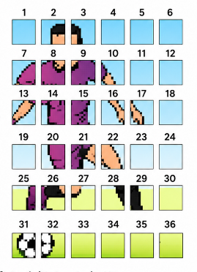
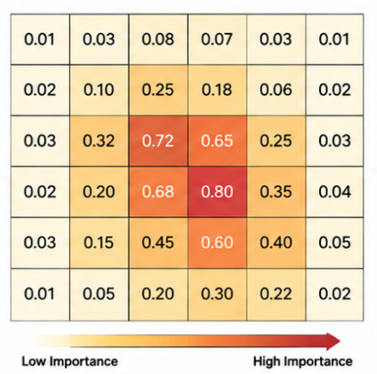


What Do We Need Next?
Scores
How can machines understand relationships between data points?
How ???
How can models focus on the most important information?
Ans: Attention
What is Attention Mechanism?
An Attention Mechanism is a technique in neural networks that allows models to focus on specific parts of input data, enhancing performance by prioritizing relevant information. This approach benefits AI applications by improving context understanding and decision-making.
How can different inputs interact and influence each other?

Slide 5
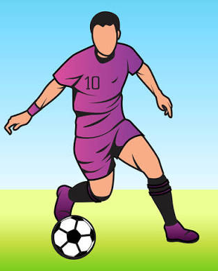
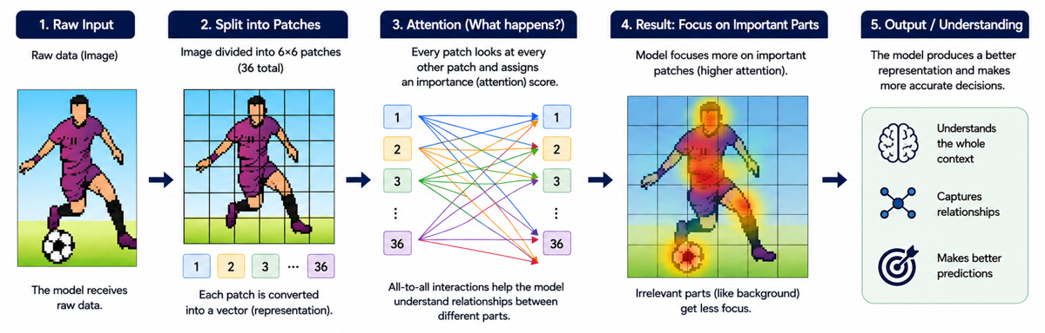
What Do We Need Next? (cont…)
Ans: Attention helps a model focusing on relevant information and understand relationships
1. Raw Input
2. Split into patches (6x6)
3. Attention
4. Results: Focus on Important Parts
5. Output/ Understanding
Input Layer
Hidden Layers
Output Layer
The Model Receives Raw data
Each patch is converted into a vector (representation)
Model understand the relationships between different parts
Irrelevant parts (like background) get less focus

Slide 6
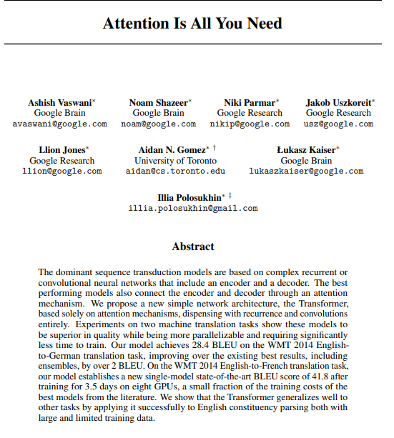
What Do We Need Next? (cont…)
https://arxiv.org/pdf/1706.03762

Slide 7
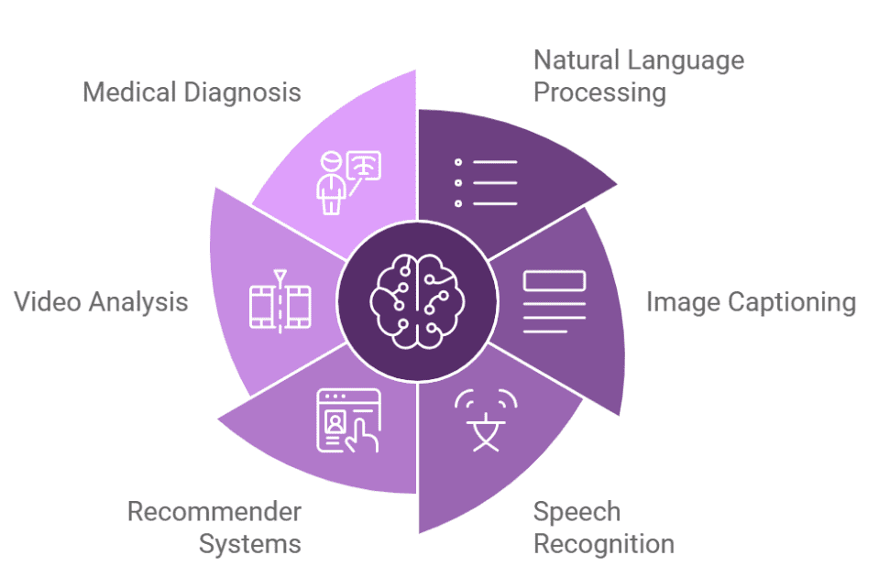
What Do We Need Next? (cont…)
Applications of Attention Mechanisms
Attention mechanisms help a model decide which parts of the input are more important for the current task. The exact meaning of “important” depends on the application.

Slide 8
What Do We Need Next? (cont…)
Application | How attention is used | Simple example
Natural Language Processing | Focuses on the most relevant words when understanding or generating text. | Connects important words and context to understand a sentence.
Image Captioning | Focuses on different image regions while generating different words. | Focus on the boy when generating “boy” and the ball when generating “football.”
Speech Recognition | Focuses on relevant parts of the audio signal when producing each word. | Links parts of the speech signal to words such as “open,” “the,” and “door.”
Recommender Systems | Gives more importance to the user's most relevant past behaviors or preferences. | Recent football-related activity can receive more attention when recommending videos.
Video Analysis | Focuses on important frames, objects, or regions instead of treating everything equally. | For detecting a fall, attention can focus on the person's movement across frames.
Medical Diagnosis | Focuses on important regions, features, or clinical information relevant to diagnosis. | A model may give higher attention to a suspicious region in a medical image.
Document Understanding | Focuses on relevant words, tables, images, and their relationships. | Connects “Total amount” with the corresponding value “$1,250” in an invoice.
Robot Manipulation | Focuses on the target object and the relevant part of the scene. | For “Pick up the red cup,” attention focuses on the red cup rather than other objects.
Key idea: Attention does not simply process everything equally—it assigns more importance to information that is relevant to the current task.

Slide 9
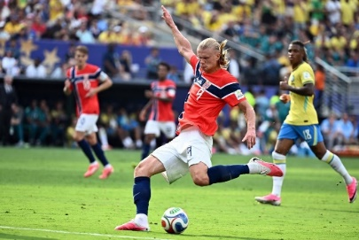
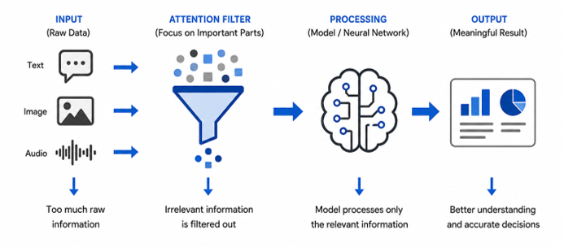
2. Why Do We Need Attention ?
The Importance of Relevant Information
Real-world data contains a lot of information, but not all of it is important.
Some information is more important than others.
Attention helps the model focus on the most important information.
  Example: 1
  The boy kicked the football
  ↓
  IMPORTANT (Boy-Kicked-Football)
  ELSE
  ↓
  NOT IMPORTANT (The)
Example: 2
Input
• Boy
• Football
• Other players
• Background
↓
Multiple Attention Heads
↓
Head 1 → Focuses on the boy
Head 2 → Focuses on the football
Head 3 → Focuses on other players
↓
All heads are combined
↓
Better understanding of the image

Slide 10



Why Do We Need Attention ? (cont…)
Context and Relationships
One part of the input may not be clear on its own.
The surrounding information helps the model understand its meaning.
Relationships can be local(nearby) or long-range(far, between).
Attention helps connect related information, even when it is far apart.
Context:
Ground Image
Boy
Football
Relationship:
Boy + Football + Ground =The Boy is Playing Football with other players on the field
Ground
Boy
Football
Attention

Slide 11
Why Do We Need Attention ? (cont…)
Attention for Weighting Information
Attention gives more weight to relevant information.
Higher weight → more influence
Lower weight → less influence
These weights are learned during training.
Attention
Equal Importance
Attention
Focused on what matters
Higher Weights
Find Relevance
No Focus
Lower weight
Higher weight

Slide 12
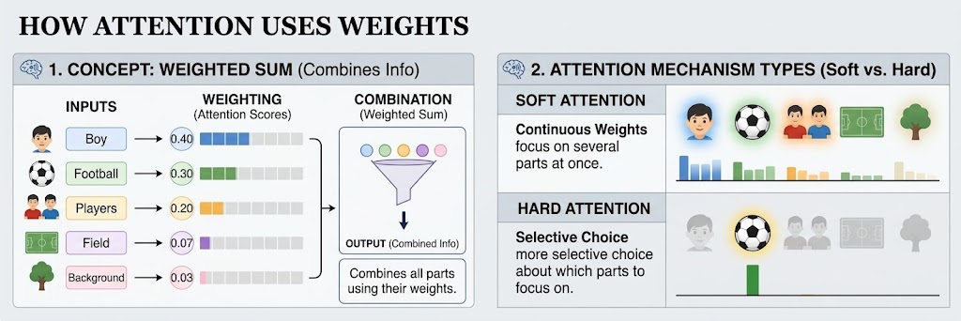
Why Do We Need Attention ? (cont…)
How Attention Uses Weights ?
Soft attention: uses continuous weights and can focus on several parts at once.
Hard attention: makes a more selective choice about which parts to focus on.
A weight is a number that tells an AI how important a piece of information is.
Combines information using different weights.

Slide 13
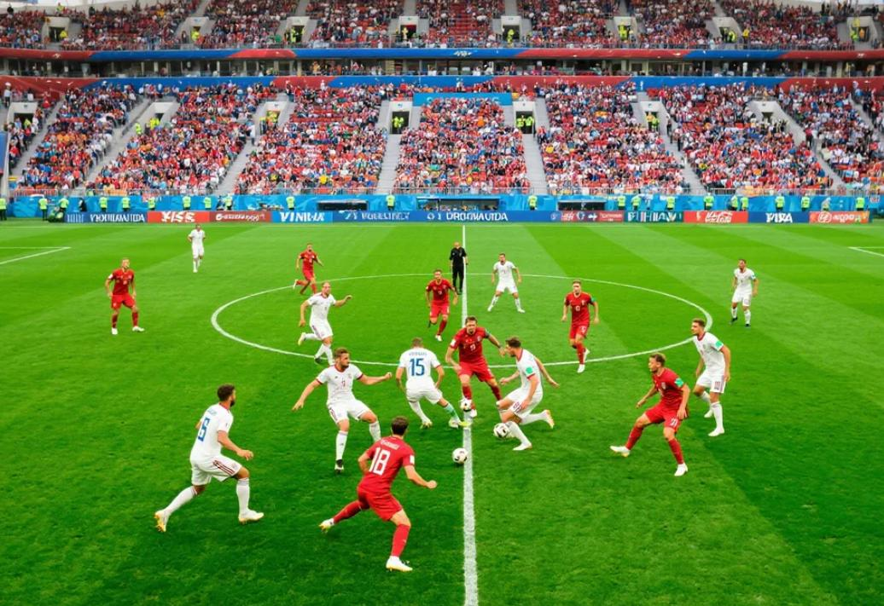

Why Do We Need Attention ? (cont…)
Soft vs Hard Attention
Example: Understanding a Football Image
Imagine an AI model is asked: "Where is the football?"
1. Soft Attention (Focus on several parts)
Gives each part of the input an importance score (weight).
Combines information from all parts, giving more importance to the relevant ones.
The model can consider several parts at the same time.
2. Hard Attention (Select specific parts)
Selects one or a few specific parts of the input to focus on.
Gives little or no attention to the unselected parts.
Makes a more selective choice rather than combining information from everywhere.
Soft Attention
The model assigns different weights to the ball, players, field, and background. It considers information from all these areas, but gives the ball a higher weight.
Hard Attention
The model selects the area containing the ball and focuses on that area, largely ignoring the other parts of the image..

Slide 14
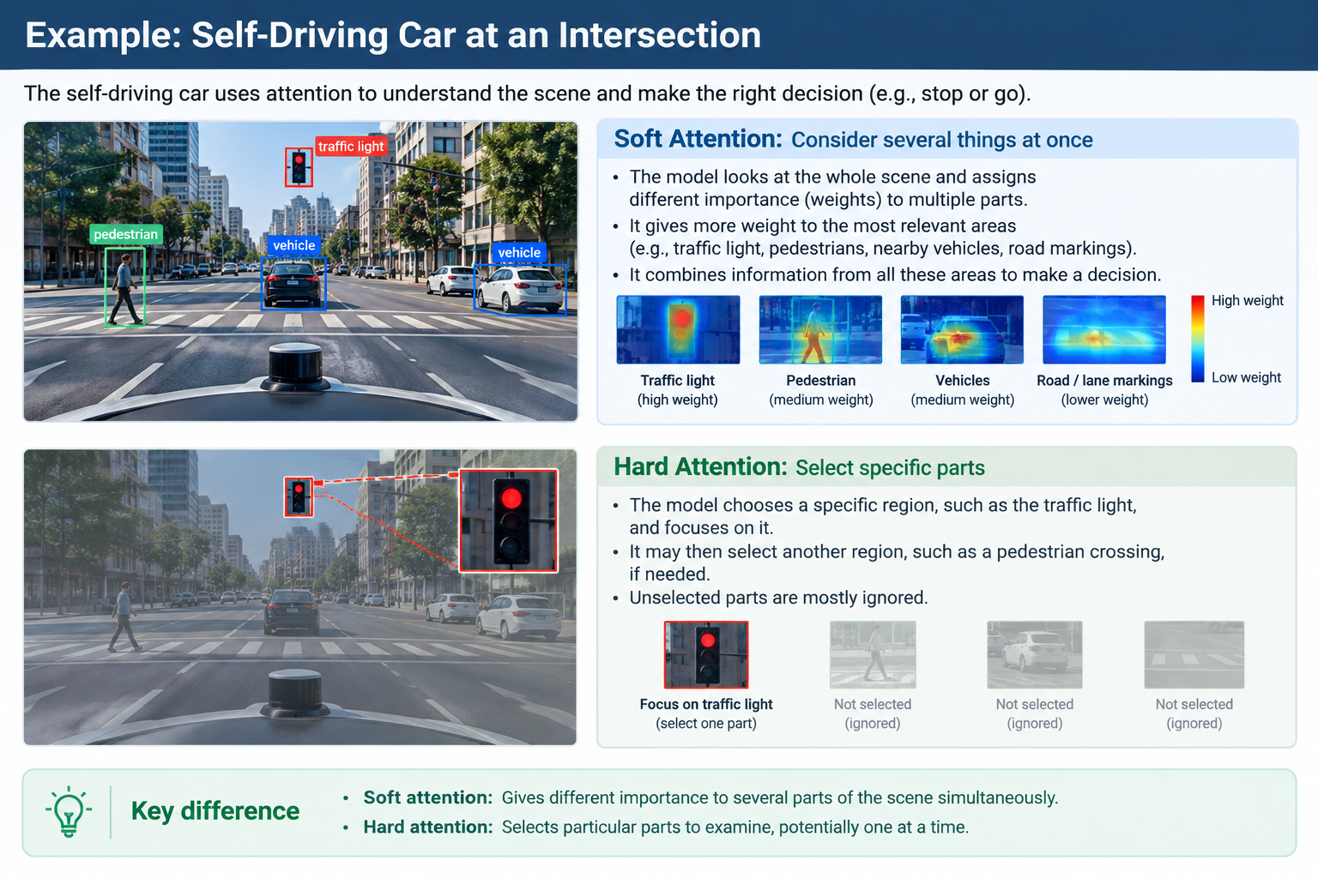
Why Do We Need Attention ? (cont…)

Slide 15
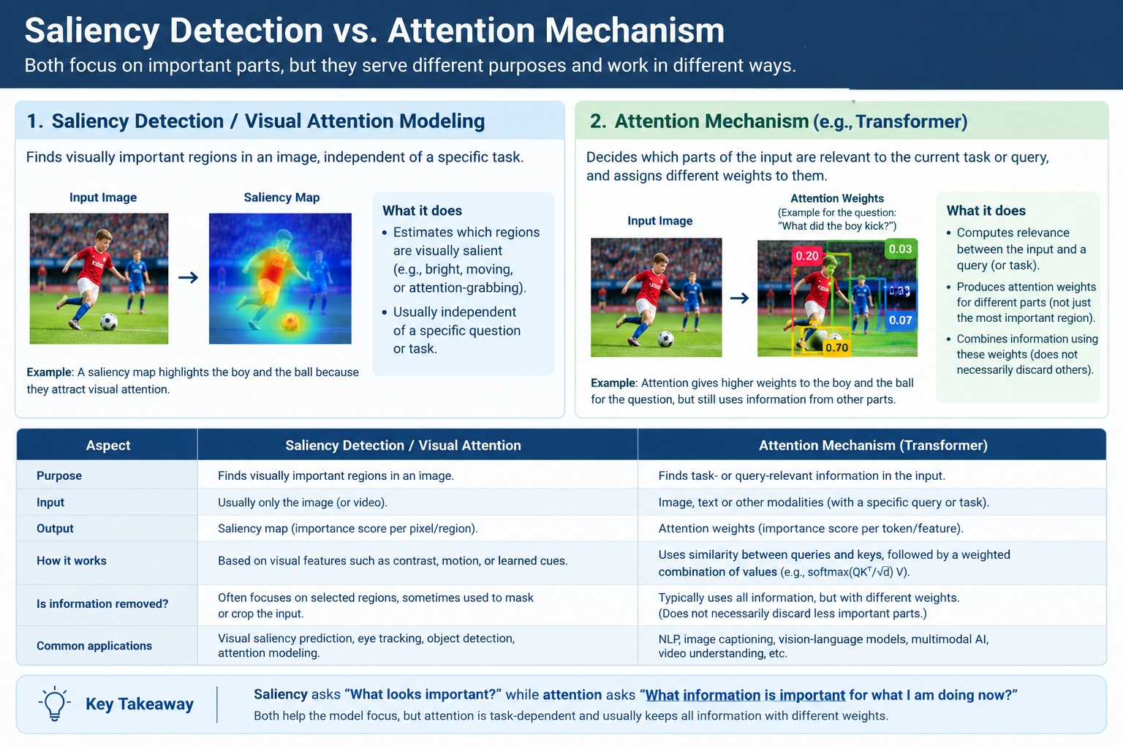

Slide 16
Self-Attention

Slide 17
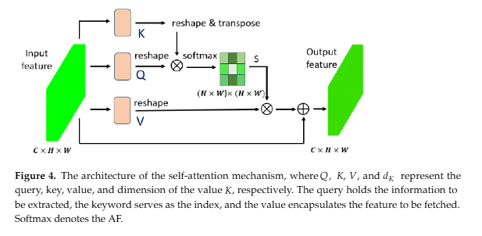
3. Self Attention
Basic Intuition
Each element can look at other elements in the same input.
Each element asks: “Which other elements are relevant to me?”
Relevant information is used to create a new representation.
(Self-Attention Mechanism)
Dynamic Connections: Self-attention lets each part of a sequence look at every other part to discover hidden relationships dynamically.
(2.3. Self-Attention Mechanism)
The architecture of the self-attention mechanism
Notes:
C = Channels → how many feature maps the model has learned.
H = Height → number of rows in the feature map.
W = Width → number of columns in the feature map.
The process is: Input Feature → Q, K, V → Attention Weights → Weighted V → Output Feature
Step 1: Input feature
The input is a feature map: C × H × W. It contains visual information extracted from an image.
Step 2: Create Q, K, and V: The input is transformed into three representations:
Q (Query): What information am I looking for?
K (Key): What information do I contain / how can I be matched?
V (Value): What information should I provide if I am relevant?
Step 3: Compare Q and K: The model calculates how strongly each position is related to the other positions.
Step 4: Softmax: The similarity scores are converted into attention weights.
Step 5: Use V: The attention weights are applied to the Value (V) representations. So, the model combines information from relevant positions, with more relevant positions contributing more.
Step 6: Output feature: The result is a new feature representation that contains contextual information from other positions.

Slide 18
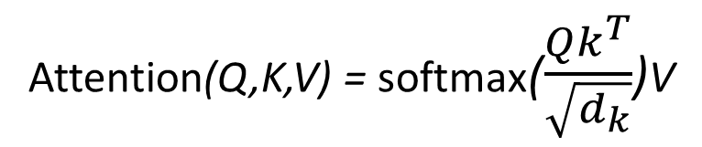
Self Attention (cont…)
Query Key Value
Query (Q): Each word serves as a query to compute the attention scores.
    what I am looking for.
Key (K): Each word acts as a key to determine its relevance to other words.
    what I can offer.
Value (V): Each word contributes as a value to the attention-weighted sum.
    what I actually offer.
Query
↓
Compare with Keys
↓
Find Relevant Information
In practice, attention is computed for multiple queries at the same time. These queries are packed into a matrix Q, while the Keys and Values are packed into matrices K and V.
The attention output is then computed as:
↓
Use corresponding Values
↓
Attention(Q,K,V) = softmax($\frac{Qk^{T}}{\sqrt{d_{k}}}$)V
Attention Output
click and see content 3.2.1

Slide 19
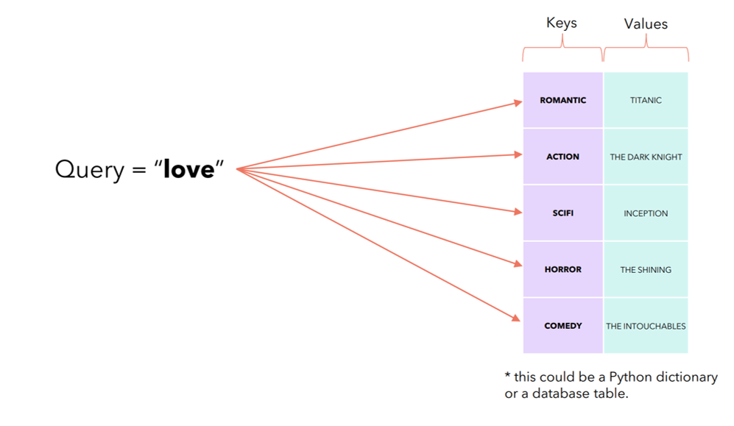
Self Attention (cont…)
https://huggingface.co/blog/Esmail-AGumaan/attention-is-all-you-need#self-attention-mechanism

Slide 20
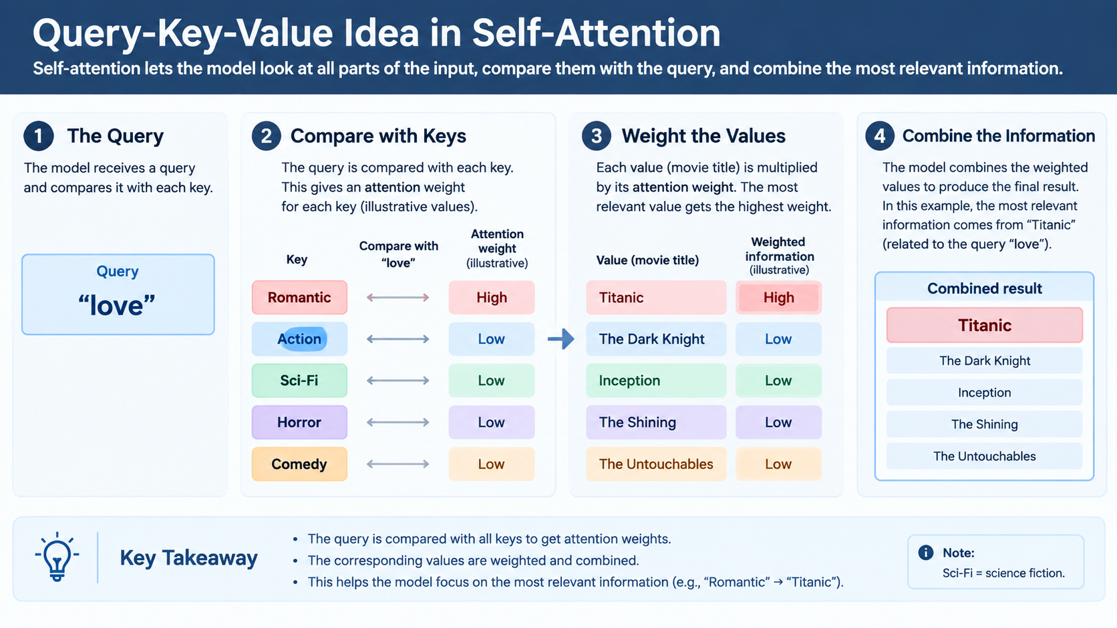

Slide 21
Self Attention (cont…)
Attention Scores & Weights
Example
Suppose we have three Values:
V₁, V₂, V₃
and their attention weights are:
71%, 9%, 20%
Then:
Attention Output = (0.71 × V₁) + (0.09 × V₂) + (0.20 × V₃)
i.e.,
V1 = Boy
V2 = Football
V3 = Football Ground
Q and K determine relevance
Weights determine importance
V provides the information
Q: How Attention Weights Are Calculated
Step 1: Compare the Query with every Key to calculate a relevance score.
Step 2: Scale the scores to keep the calculations numerically stable.
Step 3: Apply Softmax to convert the scores into weights that are positive and add up to 100%.
e.g., Scores [2.1, 0.4, 1.0] → Weights [71%, 9%, 20%]
Step 4: Multiply each Value by its corresponding weight.
A higher weight gives more influence to that Value.
Step 5: Add the weighted Values together to produce the final attention output.

Slide 22

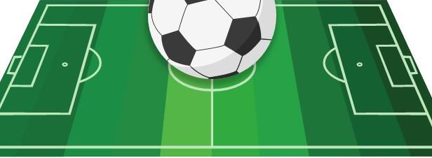

Self Attention (cont…)
↓
↓
↓
Q1, K1, V1
Boy Vectors
Q2, K2, V2
Football Vectors
Q3, K3, V3
Field Vectors
Q1 compares with K1, K2, K3
Attention weights
71%| 20% | 9%
(0.71 x V1) + (0.20 x V2) + (0.09 x V3)
Attention Outputs

Slide 23
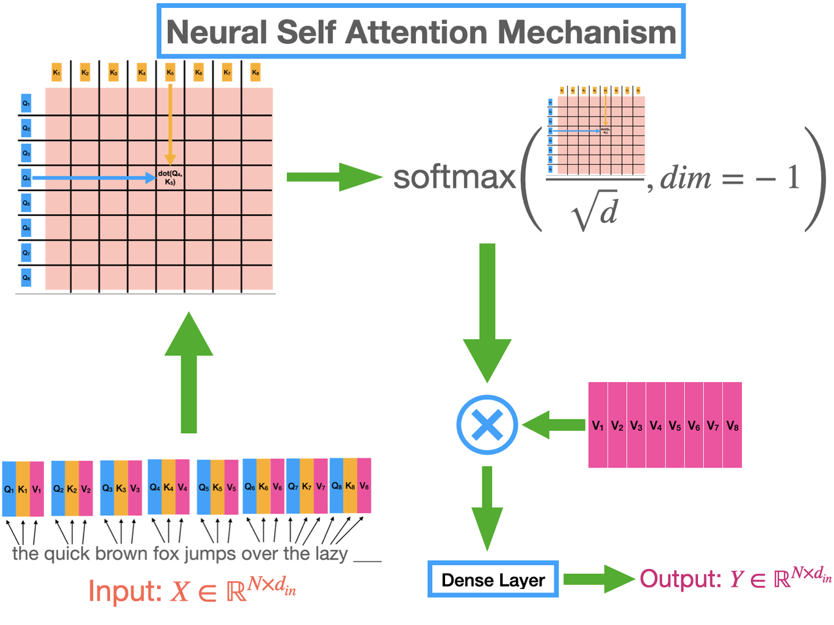
Self Attention (cont…)
How Information Interacts Within the Same Input
Each part looks at other parts of the same input.
It generates Q, K, and V from the same input.
Attention matches Q with K to find relevant information, then uses V.
Example: The boy looks at the football, players, and field to understand the situation.
It helps the model understand relationships within one input.
Figure:
Neural Self Attention Mechanism
Good source: RNNs, LSTM, Self-Attention and Multi-headed self-attention, PyTorch Implementation

Slide 24
Cross-Attention

Slide 25
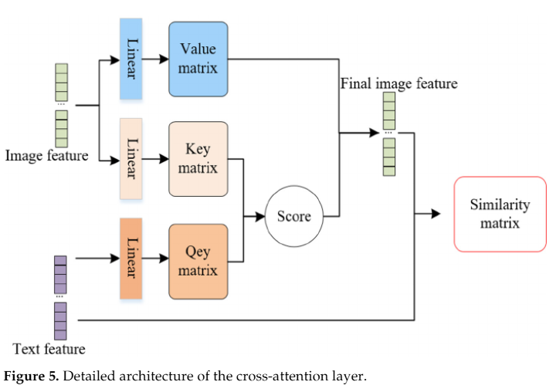
4. Cross-Attention
Basic Intuition
Cross-attention mechanism is a key part of the Transformer model.
It allows the decoder to access and use relevant information from the encoder.
This helps the model focus on important details
Cross attention enables different parts of the model to communicate and share useful information for better results.
Figure 5. Detailed architecture of the cross-attention layer

Slide 26
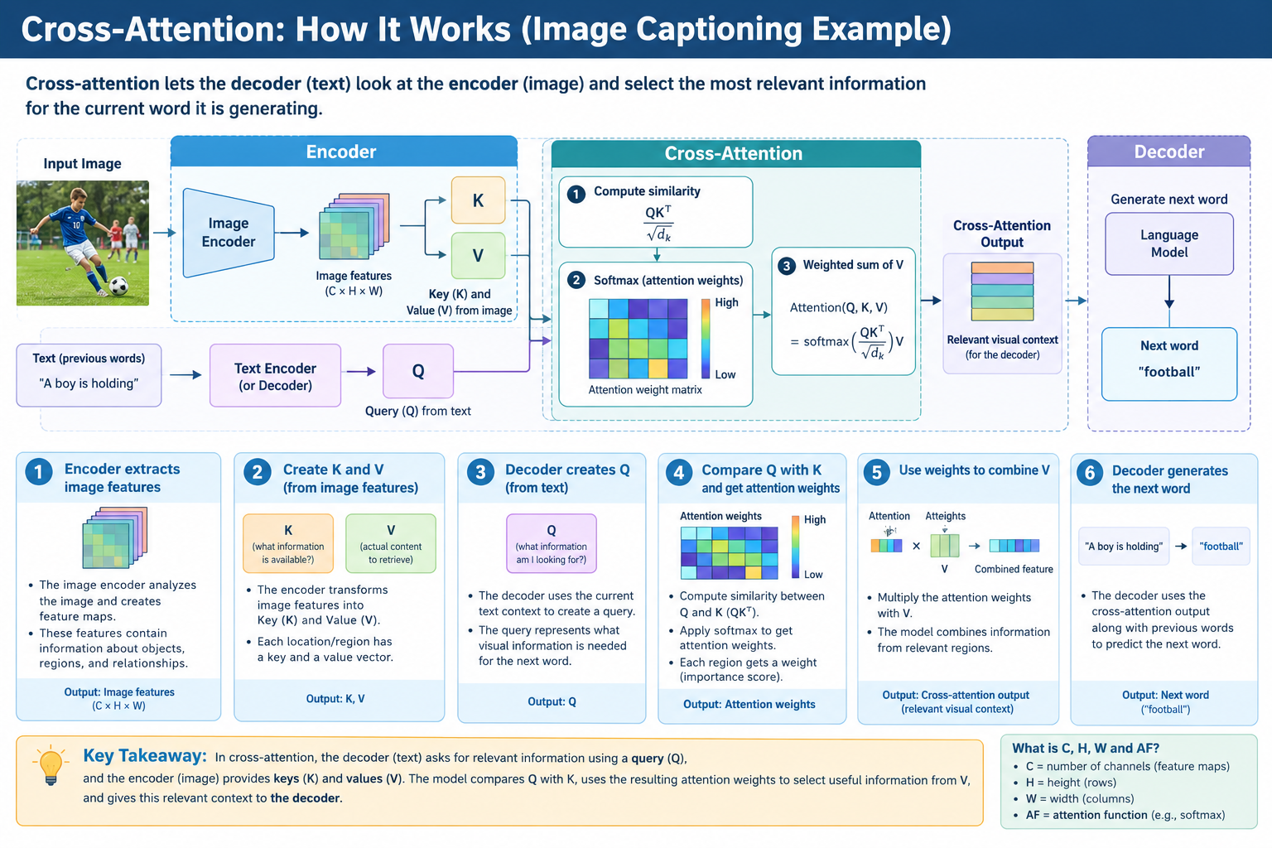

Slide 27
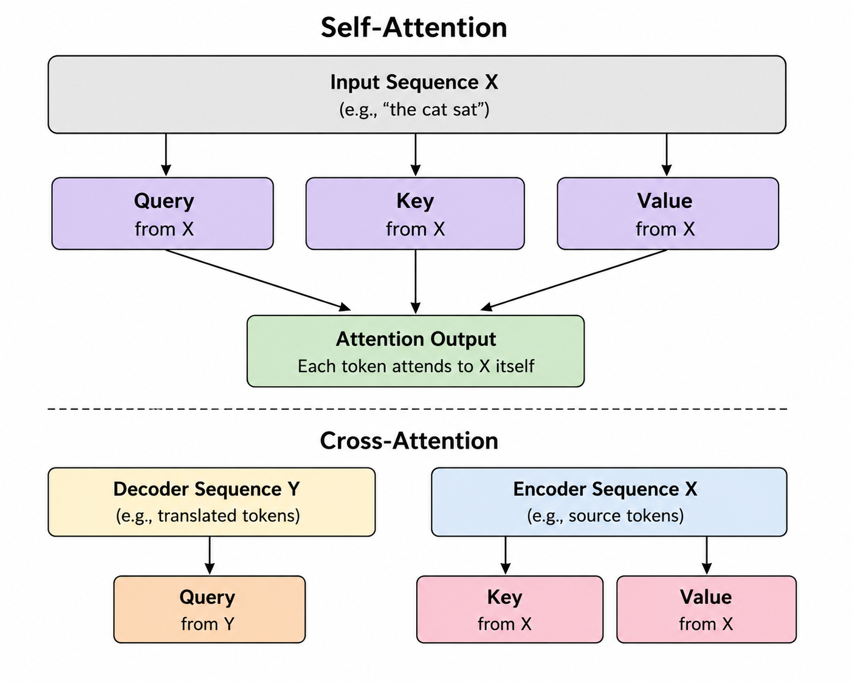
Cross-Attention (cont…)
Self-Attention vs. Cross-Attention
Self-Attention | Look within yourself. One input looks at other parts of the same input to understand their relationships.
Cross-Attention | Look at another input. One input looks at another input to find the information it needs.
Technical Difference | Both follow the same basic process: Q + K → Scores → Weights → Values → Output The main difference is where Q, K, and V come from.
Self-Attention | Q, K, and V come from the same input. Example: Boy ↔ Football = the boy is playing with the football. Boy ↔ Field = the boy is on the field.
Cross-Attention | Q comes from one input, while K and V come from another input. Example: Text + Image The text provides the Query, while the image provides the Keys and Values.

Slide 28
Cross-Attention (cont…)
Connecting Different Modalities
Bridges inputs like text, images, and audio (converted into embeddings).
How It Works:
  Query: What one input is looking for.
  Key & Value: Relevant information provided by the other input.
Example: The text question "What is the person doing?" targets image regions showing someone running.
Use Cases: Image captioning, visual question answering, and audio-text AI tasks.
Modalities
Images
Audio
Video
Text
Figure: How a single Transformer processes text, images, audio, and video by capturing connections within each data type?

Slide 29
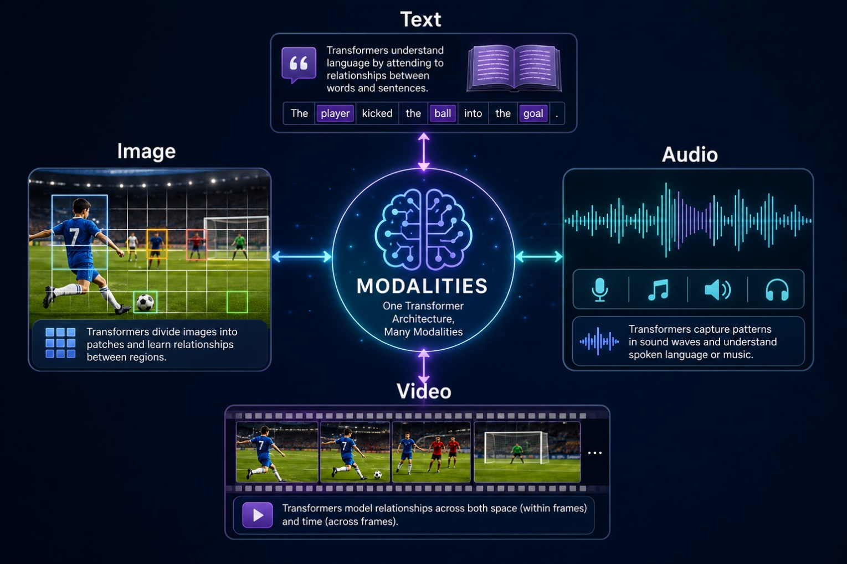
Cross-Attention (cont…)
Unified Architecture For Multimodal Data
This diagram shows how one AI architecture (the Transformer) can understand text, images, audio, and video all at once.
It works by breaking them into small pieces and connecting them together.
Figure 1: How a single Transformer processes text, images, audio, and video by capturing connections within each data type?

Slide 30
From Attention to Transformers

Slide 31
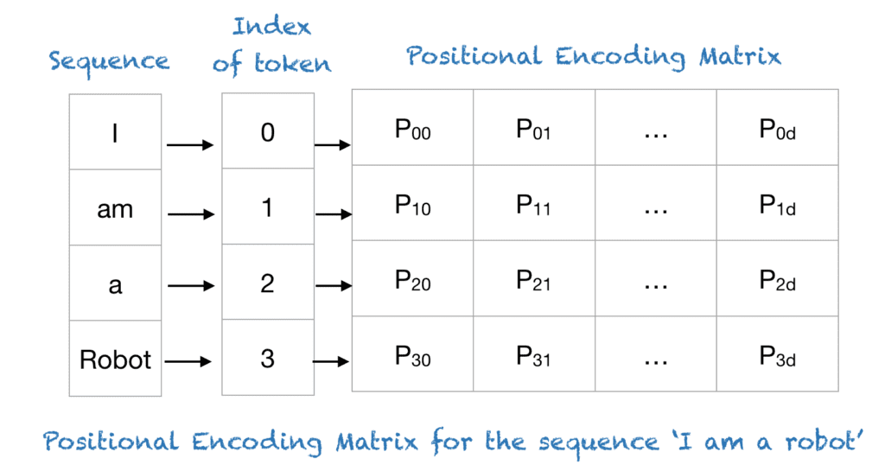
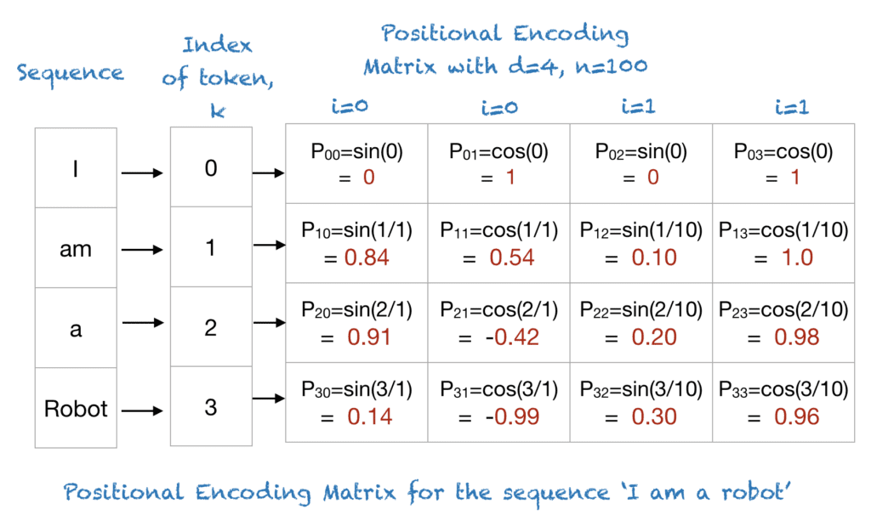
5. From Attention to Transformers
Positional Encoding
What Is Positional Encoding?
Positional encoding describes the location or position of an entity in a sequence
Each position is assigned a unique representation.
This helps the Transformer model understand the order and location of elements in the input.
Position is important because the same elements can have different meanings when their positions change.
e.g., “A car is in front of the tree.” and “A tree is in front of the car.”
Attention tells the model what is related
Positional Encoding tells it where each element is and helps distinguish meaning based on position.
Notes:
d = how many positional numbers each token gets.
n = controls the scale/frequency of the sinusoidal patterns.
i = identifies each sine-cosine pair.
position = tells us which token we are encoding.
sin and cos = create the distinctive positional pattern.
Don't focus too much on the individual calculations. The main purpose is: Each position gets a unique numerical pattern.
For example:
“I” → position 0 → [0, 1, 0, 1]
“am” → position 1 → [0.84, 0.54, 0.10, 1.00]
“a” → position 2 → [0.91, −0.42, 0.20, 0.98]
“Robot” → position 3 → [0.14, −0.99, 0.30, 0.96]
The Transformer can then use these patterns to understand where each token occurs in the sequence.

Slide 32
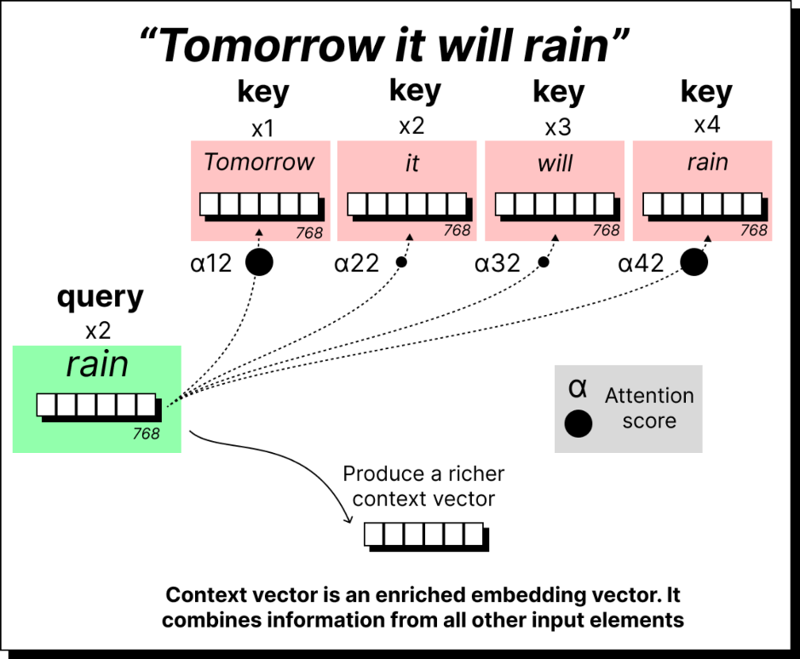
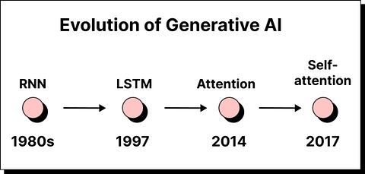
From Attention to Transformers (cont…)
Why Transformers Use Attention as a Core Mechanism ?
As we know Older models, such as RNNs, process information one step at a time, making them slower to train.
In long sequences, information from earlier parts can become harder to use.
Attention connects relevant elements and processes them in parallel.
This makes Transformers faster and more efficient.
Example Figure
From RNNs to Attention

Slide 33
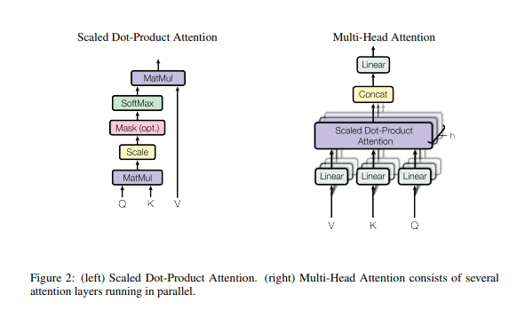
From Attention to Transformers (cont…)
Scaled Dot-Product Attention
Measures how relevant inputs are to each other using Q, K, and V.
Scaling and softmax help assign appropriate attention weights.
This allows the model to focus on the most relevant information.
Multi-Head Attention
Uses multiple attention heads in parallel.
Each head learns to focus on different relationships or patterns.
Their outputs are combined to create a richer representation.
https://arxiv.org/pdf/1706.03762

Slide 34
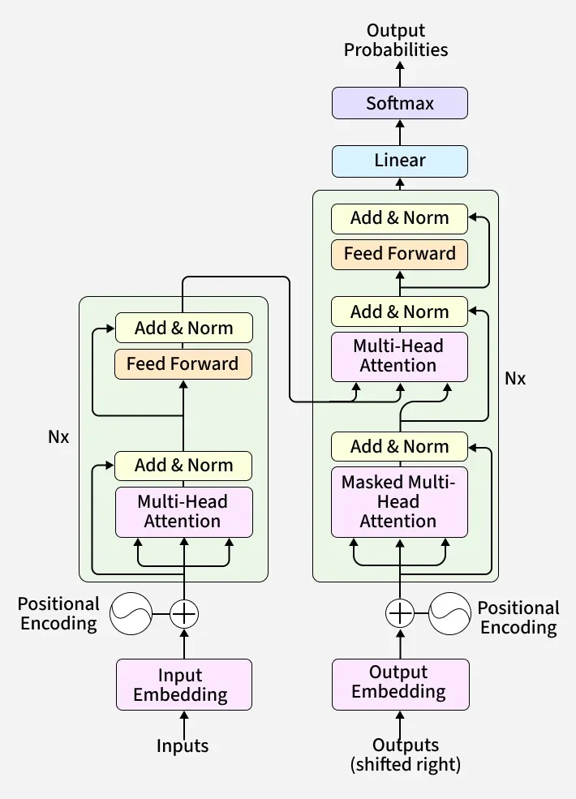
From Attention to Transformers (cont…)
Transformer Architecture
A Transformer is built by stacking multiple Encoder and Decoder blocks.
Encoder
Input Embedding: converts input tokens into numerical vectors.
Positional Encoding: adds information about the position of each token.
Multi-Head Attention: captures different relationships between input tokens.
Feed-Forward Network: further processes the attended information.
Residual (Add) + Normalization (Norm): help preserve information and keep values stable across layers.
Decoder
Output Embedding: converts output tokens into vectors; during training, the target sequence is shifted right.
Masked Multi-Head Attention: lets each position attend only to earlier tokens, preventing access to future tokens.
Cross-Attention: connects the Decoder to the Encoder's output and focuses on relevant input information.
Feed-Forward Network: further transforms the information.
Residual (Add) + Normalization (Norm): help information flow through the layers.
Output
Linear: projects the Decoder output to the size of the vocabulary.
Softmax: converts the values into probabilities for the next token.
https://youtu.be/X_lyR0ZPQvA
Overall Transformer Architecture, detailing Encoder and Decoder stacks with their respective sub-layers and data flow

Slide 35
Transformers Across Modalities
How Transformers process each type of input

Slide 36
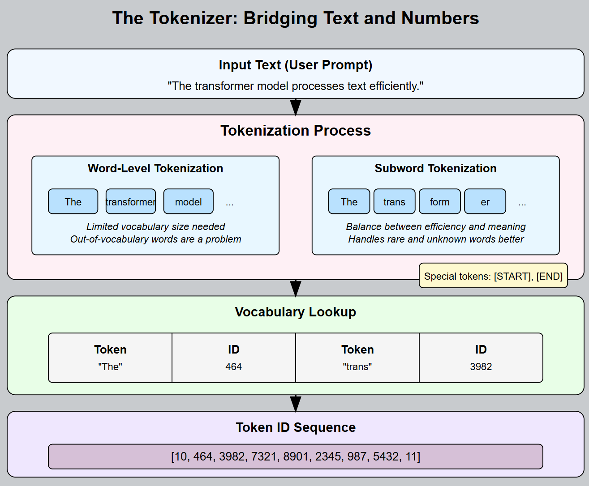
6. Transformers across Modalities
Text → Tokens
Before a Transformer can process text, the text is split into smaller units called tokens. These can be whole words or parts of words.
  e.g., “unbelievable” may be split into “un” + “believe” + “able.”
Each token is converted into an embedding layer.
Positional encoding for the position of each token in the sequence.
The result is a sequence of vectors containing both meaning and position, which is then given to the Transformer.
Text → Tokens → Embeddings + Positional Encoding → Transformer

Slide 37

Transformers across Modalities (cont…)
Images → Patches
The image is divided into small, fixed-size patches.
  e.g., a 224 × 224 image divided into 16 × 16 patches produces a 14 × 14 grid, giving 196 patches.
Each patch is flattened and converted into an embedding vector.
Positional encoding is added so the model knows where each patch is located in the image.
The result is a sequence of patch embeddings, similar to a sequence of word embeddings in text.
Image → Patches → Patch Embeddings + Positional Encoding → Transformer

Slide 38
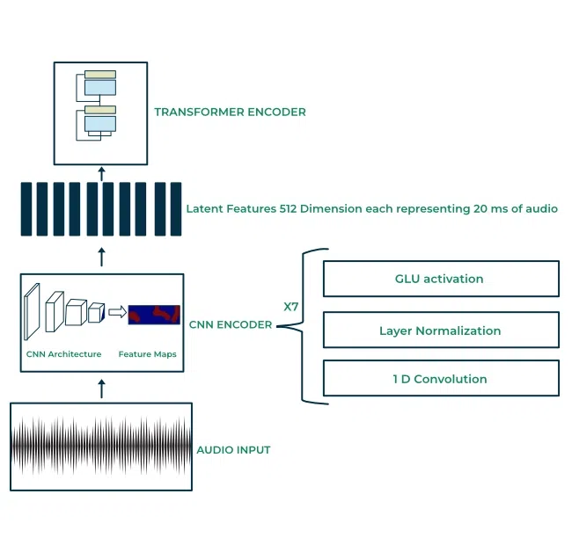
Transformers across Modalities (cont…)
Audio → Segments
Audio is a continuous waveform, so it is divided into short time segments, often called frames.
Each segment is converted into features, such as a spectrogram, and then into an embedding vector.
Positional encoding is added so the model knows the order of the segments in time.
The result is a sequence of audio embeddings that can be processed by the Transformer.
Example: The 5th segment keeps its position, so the model knows when it occurs.
Audio → Segments → Audio Embeddings + Positional Encoding → Transformer

Slide 39
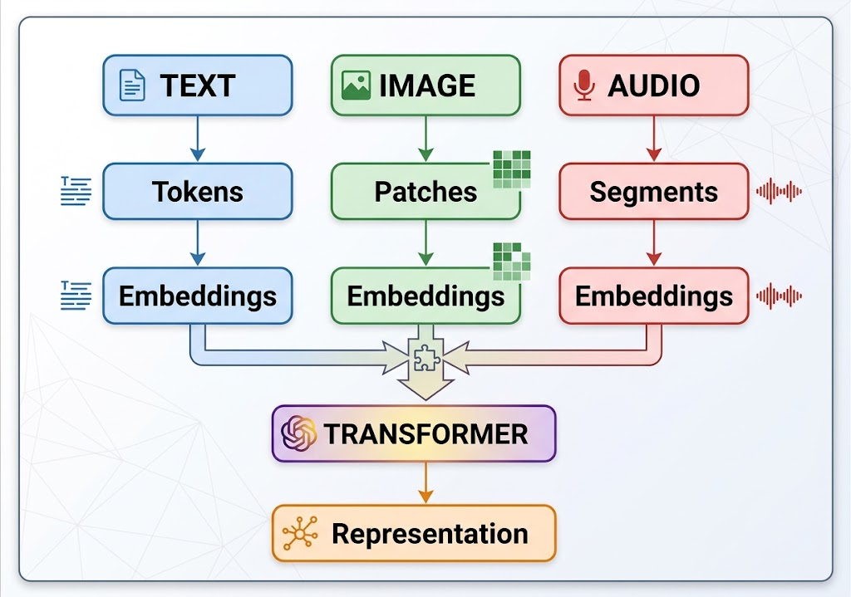
Transformers across Modalities (cont…)
A Common Attention-Based Architecture Across Inputs
Text, images, and audio are converted into different types of input units.
These units are converted into embeddings, giving each modality a common vector-based representation.
Once represented as embeddings, they can be processed by a Transformer architecture.
The Transformer uses core components such as self-attention, multi-head attention, feed-forward layers, and normalization.
The main difference is how each modality is converted into tokens or segments before entering the Transformer.
Different inputs → Different representations → Embeddings → Attention-Based Transformer

Slide 40
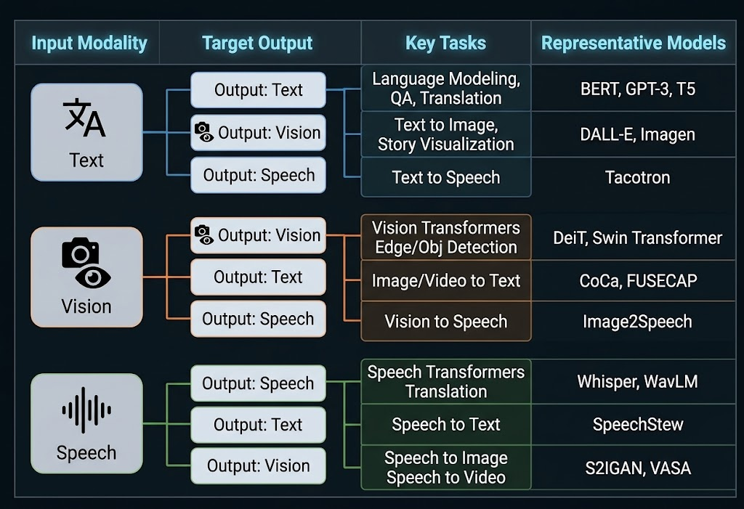
Transformers across Modalities (cont…)
Overview of Cross-Modal AI Models & Applications
Start with Input: You give the AI text, a picture, or audio.
Choose Output: You decide what form you want the result to be in.
Define Task: The AI picks the exact job to do (e.g., Text to Image or Speech to Text).
Name the Tool: Real-world AI models (like GPT, DALL-E, or Whisper) execute that specific path.
Figure 1: Overview of multimodal AI workflows—mapping input data types to target outputs, specific processing tasks, and real-world models.

Slide 41
Transformers for Multimodal AI
How Transformers connect multiple types of input together

Slide 42



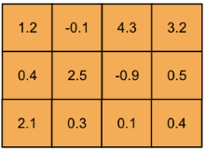
7. Transformers for Multimodal AI
Vision
Language
Vision + Language
Images and text are converted into embeddings.
Cross-attention connects the two modalities, allowing information from one to influence the other.
  Example: “What color is the car?” → the text focuses on the relevant image region → “Red.”
This supports tasks such as image captioning, visual question answering, and image–text retrieval.
During training, paired images and text help the model learn relationships between visual content and language.
Vision provides visual information + Language provides meaning → Cross-Attention connects them.
↓
↓
What color is the car?
↓
↓
“what” “color” “is” “the ” “car” “?”
↓
↓
Self-Attention
↓
Cross-Attention
Image Captioning
O
U
T
P
U
T
↓
Multimodal Understanding
VQA
Image-Text Search

Slide 43

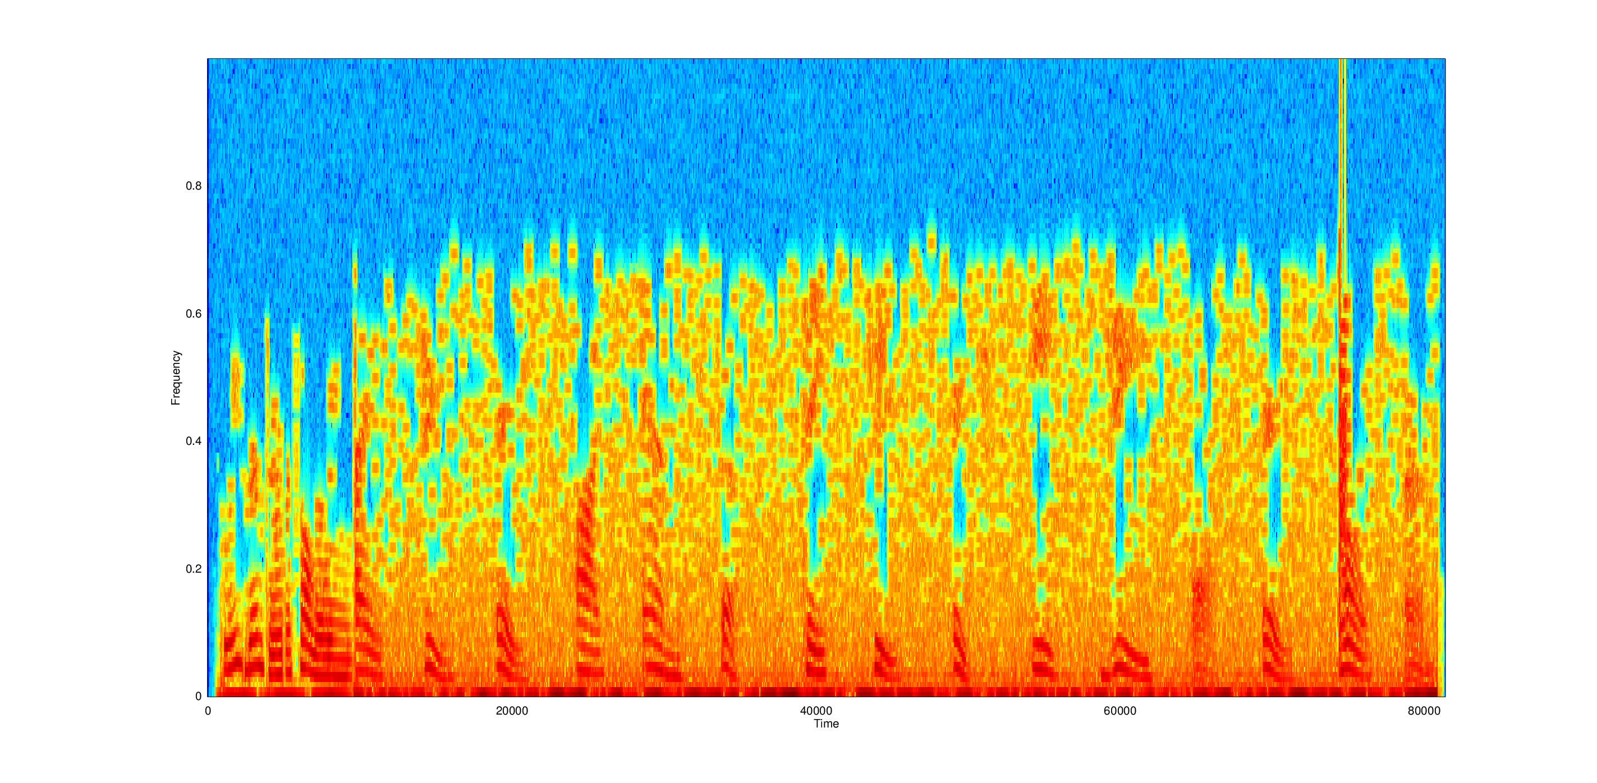
Transformers for Multimodal AI (cont…)
Audio + Language
Audio is divided into short segments and converted into audio embeddings, while text is represented as word or sub-word tokens.
Cross-attention connects the two modalities, allowing language to use relevant information from the audio.
  Example: A spoken lecture → the model focuses on relevant audio segments → written transcript.
This supports tasks such as speech recognition, speech translation, and audio captioning.
The same approach can work in the opposite direction, where text guides speech generation.
Audio provides spoken information + Language provides meaning → Cross-Attention connects them.
Audio
Language
↓
↓
A bird can fly
↓
↓
“A” “Bird” “can” “fly”
↓
↓
Self-Attention
↓
Cross-Attention
Speech Recognition
O
U
T
P
U
T
↓
Multimodal Understanding
Translation
Audio Captioning

Slide 44
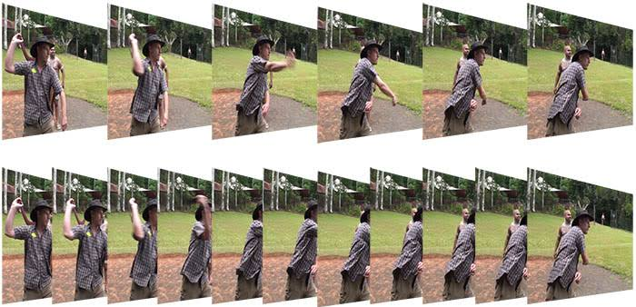

Transformers for Multimodal AI (cont…)
Video + Language
Video contains visual information and time. Each frame can be divided into patches and converted into embeddings.
The model needs to understand where something appears and when it happens.
Cross-attention connects language with video, allowing a text query to focus on relevant frames and regions.
  Example: “When does the person throw?” → the model focuses on the relevant frames → identifies the action.
This supports tasks such as video captioning, video question answering, and video search.
Video provides visual information over time + Language describes what to look for → Cross-Attention connects them.
Video
Language
↓
↓
When does the person throw ?
↓
↓
“when” “does” “the” “person” “throw” “?”
↓
↓
120fps
Self-Attention
↓
Video Captioning
O
U
T
P
U
T
Cross-Attention
↓
Multimodal Understanding
VQA
Video Search

Slide 45
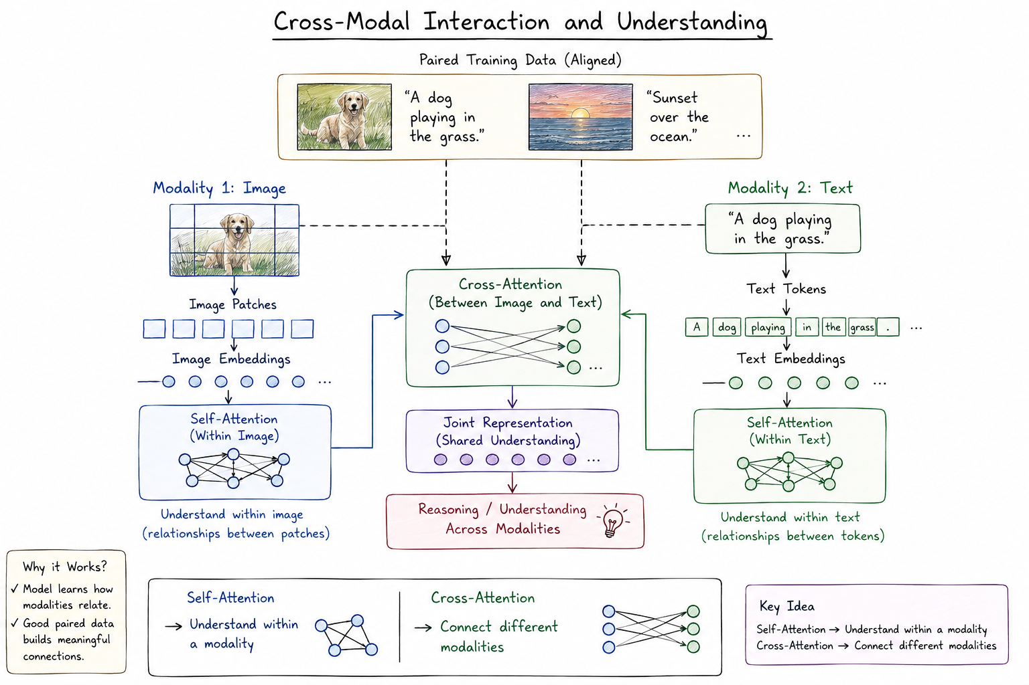
Transformers for Multimodal AI (cont…)
Cross-Modal Interaction and Understanding
Combining different modalities is not enough; the model must learn how they are related.
Self-attention helps each modality understand its own information.
Cross-attention allows different modalities to exchange relevant information.
This enables the model to understand and reason across modalities rather than processing each modality separately.
Self-Attention: Understand within a modality
Cross-Attention: Connect different modalities
Figure 1: Overall architecture of Vision-Language Transformers

Slide 46
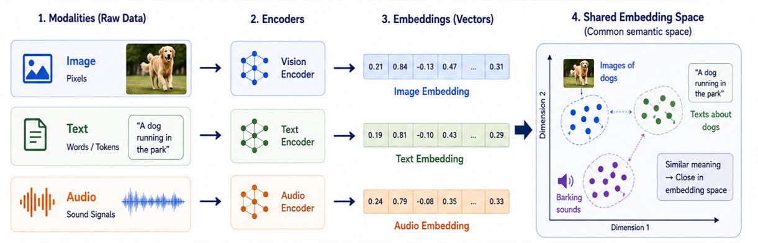
Transformers for Multimodal AI (cont…)
Understanding How AI Connects Different Data Types (Shared Embedding Space)
Modalities (Raw Data): Different types of input, like pictures, text, or sound.
Encoders: AI translators that convert each data type into numbers.
Embeddings: Lists of numbers (vectors) that represent the actual meaning of the data.
Shared Space: A map where items with similar meanings (like a dog photo and the word "dog") are placed right next to each other.

Slide 47
Case Study:
One Transformer Architecture Family Across Modalities

Slide 48

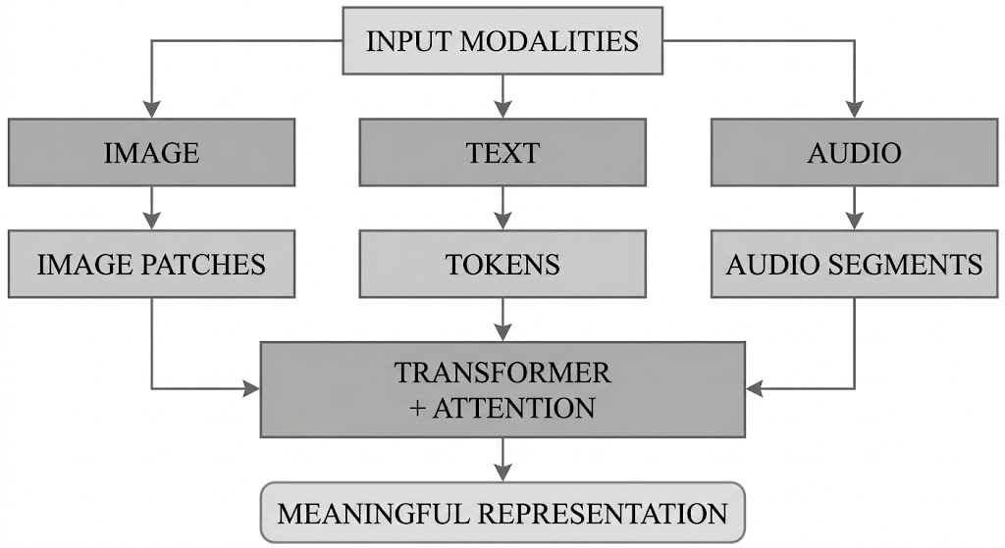


8. Case Study: One Transformer Architecture Family Across Modalities
Patches → Embeddings
Self-attention learns relationships between image regions.
Segments → Embeddings
Self-attention learns relationships across time.
Tokens → Embeddings
Self-attention learns relationships between words/tokens.
Different inputs require different ways of creating tokens or segments, but they can be processed using the same Transformer architecture.

Slide 49
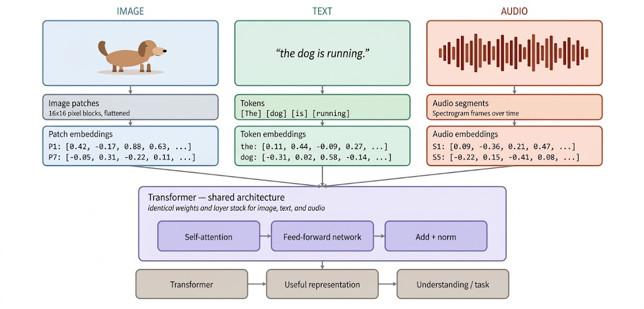
Case Study: One Transformer Architecture Family Across Modalities (cont…)
Multimodal Data Tokenization & Transformer Processing
Figure: How Images, Text, and Audio Are Broken Down, Encoded, and Unified by a Single Transformer Model

Slide 50
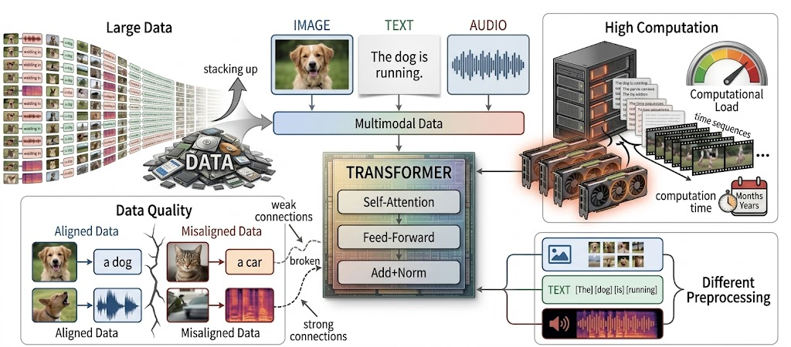
Case Study: One Transformer Architecture Family Across Modalities (cont…)
Practical Limitations
Large Data: Training needs large amounts of well-aligned multimodal data.
High Computation: Attention can be expensive for long sequences, especially video.
Data Quality: Poor data can lead to weak connections between modalities.
Preprocessing: Different modalities require different preprocessing before entering the Transformer.
Figure 1: Key challenges and main requirements for training Multimodal Transformers, including the need for large amounts of data, high computing power, well-aligned datasets, and specialized preprocessing.
Multimodal Transformers are powerful, but they require large, high-quality datasets, substantial computational resources, and modality-specific preprocessing.

Slide 51
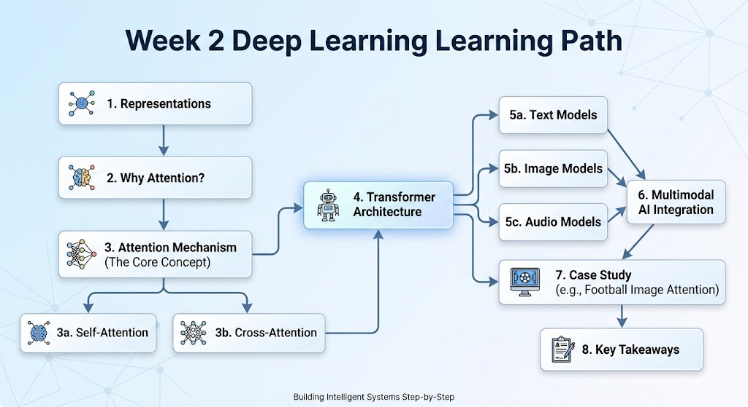
9. Summary
The Entire Overflow
Attention focuses on the most relevant information to understand context.
Self-Attention captures relationships within the same input.
Cross-Attention connects information from different inputs or modalities.
Transformers use attention to process information in parallel rather than step by step.
Images, text, and audio can be converted into tokens or embeddings, allowing Transformers to process them together.
Figure 1: Step-by-step roadmap showing how attention mechanisms power Transformer architectures to unite text, image, and audio models

Slide 52
Any Question?
Thank You!

